Slide 1
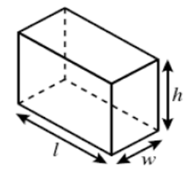
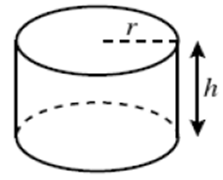
Volume and Surface Area
Is About…
determining if a practical problem involving a rectangular prism or cylinder represents the application of volume or surface area and then solving.
Main Idea
Main Idea
Volume
Surface Area
Essential Details
Essential Details
The amount of 3-dimensional space an object occupies. Capacity. How much it can hold inside. Fill it up. Filling a box with water.
The total area of the surface of a 3-dimensional object. How much it takes to cover an object. Cover/Wrap. Wrapping a box in paper.
Rectangular Prism
Rectangular Prism
$$V=lwh$$
$$SA=2lw+2lh+2wh$$
Cylinder
Cylinder
$$V=πr^{2}h$$
$$SA=2πrh+2πr^{2}$$
$$π=3.14$$
$$π=3.14$$
So What:
→ A toy manufacturer who needs to figure out how much plastic they need to make balls would need to know the surface area of the ball. → An astronomer who wants to calculate how much the sun weighs would need to know its volume. → A cartographer who wants to know how much land there is on Earth needs to know its surface area. → A pharmaceutical company making round pills needs to know the dosage of medicine in each pill, which is found by its volume

Slide 2
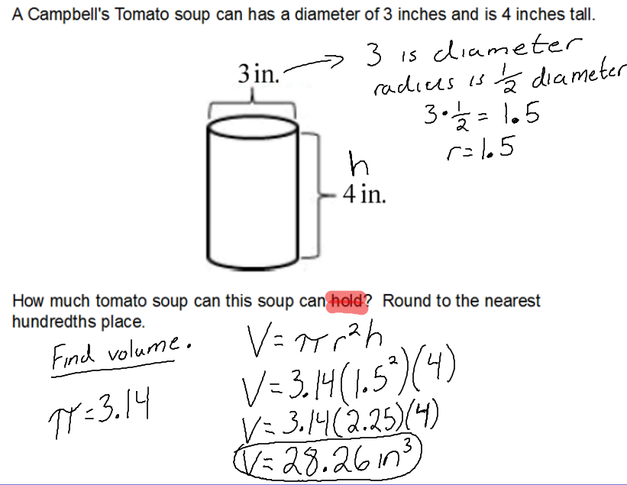
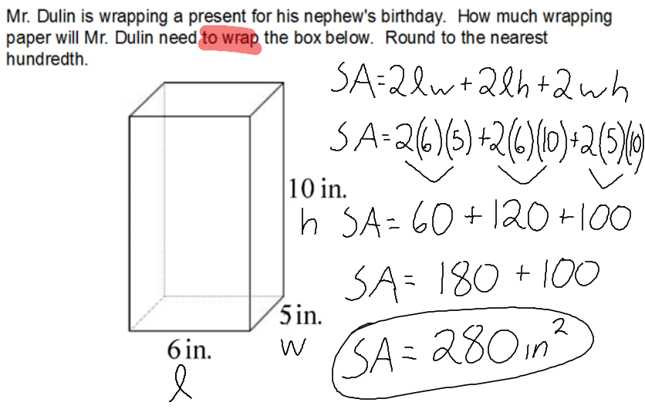
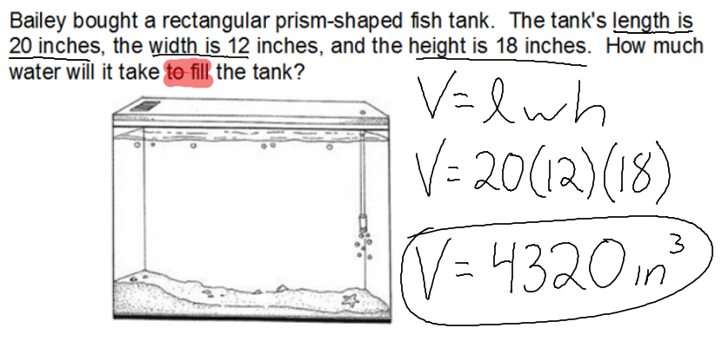

Slide 3
Volume and Surface Area
Is About…
determining if a practical problem involving a rectangular prism or cylinder represents the application of volume or surface area and then solving.
Main Idea
Main Idea
Volume
Surface Area
Essential Details
Essential Details
So What:

Slide 4
