Slide 1
The FRAME Routine
Key Topic
Writing and Evaluating Algebraic
Expressions and Equations
is about…
Writing verbal expressions and equations as algebraic expressions and equations; while evaluating algebraic expressions for given replacement values for given variables.
Main idea
Main idea
Main idea
$$Addition$$
$$Subtraction$$
$$Multiplication$$
Main idea
Main idea
Main idea
$$Division$$
$$Equals$$
$$Inequalities$$
So What? (What’s important to understand about this?)
How can algebraic expressions and equations be written?

Slide 2
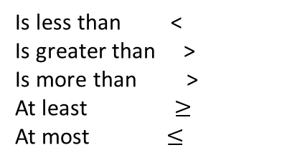
The FRAME Routine
Key Topic
Writing and Evaluating Algebraic
Expressions and Equations
is about…
Writing verbal expressions and equations as algebraic expressions and equations; while evaluating algebraic expressions for given replacement values for given variables.
Main idea
Main idea
Main idea
$$Addition$$
$$Subtraction$$
$$Multiplication$$
increased by more than combined, together total of sum added to
decreased by minus, less difference between/of less than, fewer than
of times, multiplied by product of
Main idea
Main idea
Main idea
$$Division$$
$$Equals$$
$$Inequalities$$
per, a out of ratio of, quotient of percent (divide by 100)
is, are, was, were, will be gives, yields sold for
Is less than <
Is greater than >
Is more than >
At least $≥$
At most $≤$
So What? (What’s important to understand about this?)
How can algebraic expressions and equations be written? (Word phrases and sentences can be used to represent algebraic expressions and equations. Using variables and numbers.)

