Slide 1
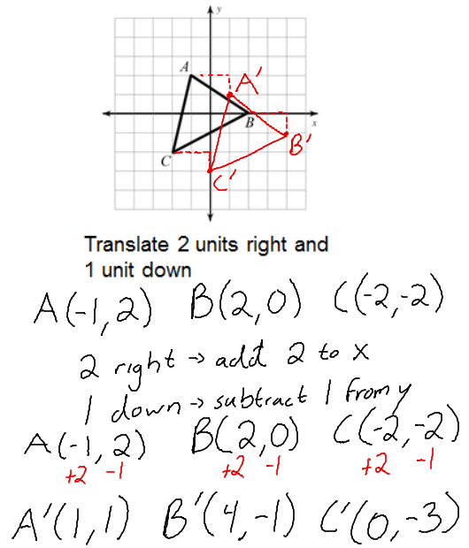
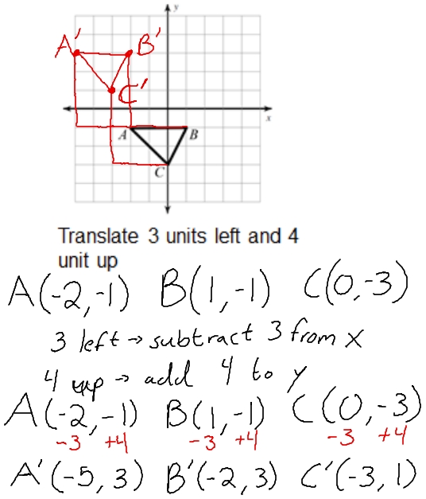
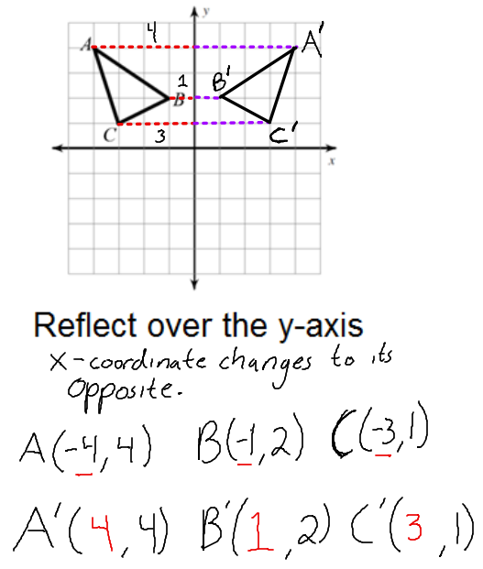
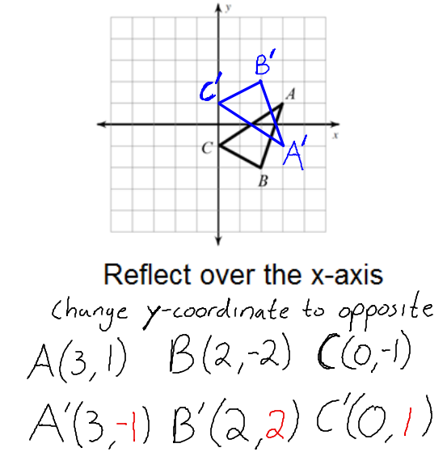
The FRAME Routine
Key Topic
Transformations
is about…
identifying and sketching translations, reflections, rotations, and dilations of a given polygon by graphing in the coordinate plane.
Main idea
Main idea
Translation
Reflection
A translation of a geometric figure is a slide of the figure in which all the points on the figure move the same distance in the same direction.
Translate horizontally left or right (left subtract/ right add to the x-coordinate)
Translate vertically up or down (down subtract/ up add to the y-coordinate)
You reflect over a line of reflection.
If you reflect over the x-axis the y-coordinate changes to its opposite.
If you reflect over the y-axis the x-coordinate changes to its opposite.

Slide 2
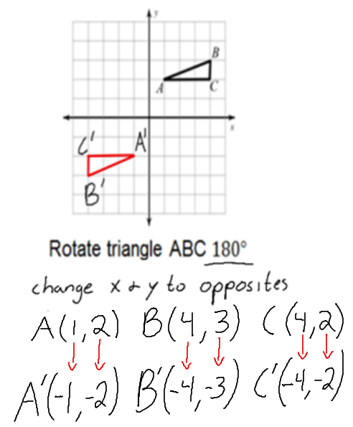
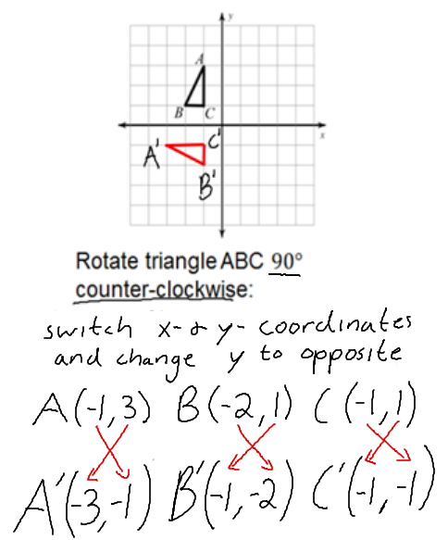
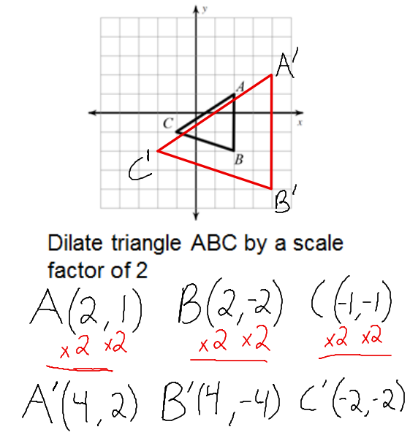
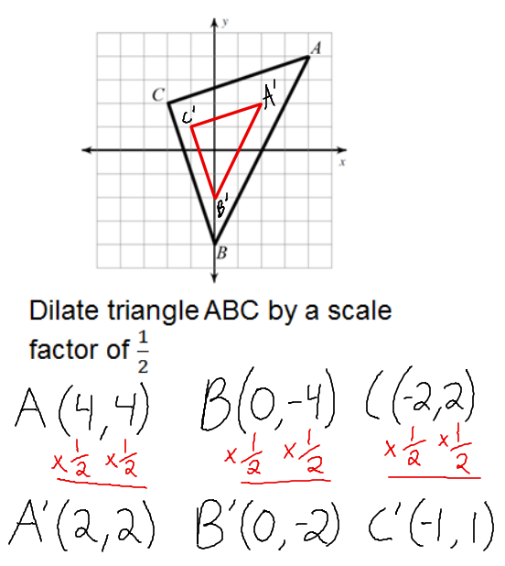
Main idea
Main idea
Rotation
Dilation
A rotation of a geometric figure is a turn of the figure around a fixed point. The point may or may not be on the figure. The fixed point is called the center of rotation.
$\frac{1}{4}turn=90° \frac{1}{2}turn=180° \frac{3}{4}turn=270° full turn=360°$
Rotate $180°$ change x and y coordinate to their opposites $\left(−x, −y\right)$
Rotate $90°$ clockwise switch places of x and y coordinate and change x coordinate to its opposite $(y, −x)$
Rotate $90°$ counter clockwise switch places of x and y coordinate and change the y coordinate to its opposite $(−y, x)$
A dilation of a geometric figure is a transformation that changes A the size of a figure by scale factor to create a similar figure.
When the scale factor “a” is:
Greater than 1 the pre-image is enlarged
Less than 1 the pre-image is reduced
Equal to 1 the pre-image stays the same
How does the transformation of a figure affect the size, shape, and position of that figure?
Translations, rotations and reflections do not change the size or shape of a figure. A dilation of a figure and the original figure are similar (changes the size). Reflections, translations and rotations usually change the position of the figure.

Slide 3
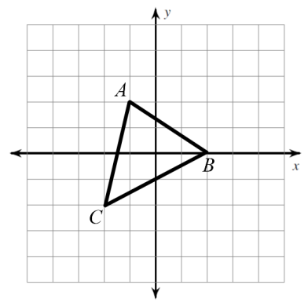
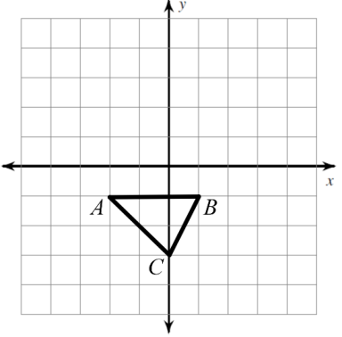
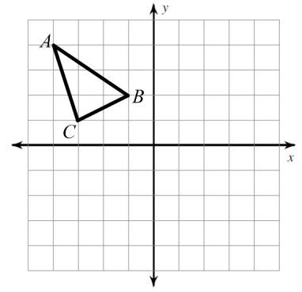
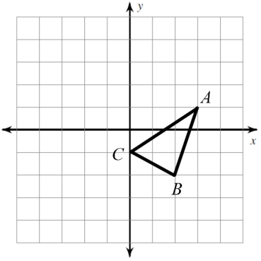
The FRAME Routine
Key Topic
Transformations
is about…
identifying and sketching translations, reflections, rotations, and dilations of a given polygon by graphing in the coordinate plane.
Main idea
Main idea
Translation
Reflection
Translate 2 units right and 1 unit down
Translate 3 units left and 4 unit up
Reflect over the y-axis
Reflect over the x-axis

Slide 4
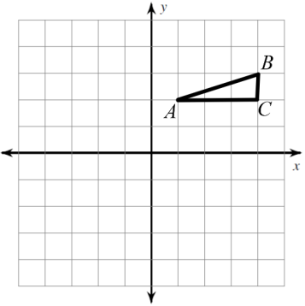
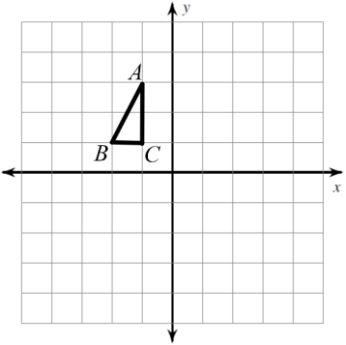
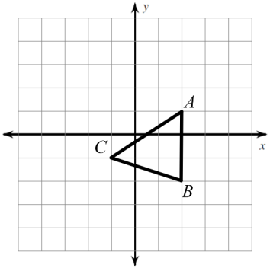
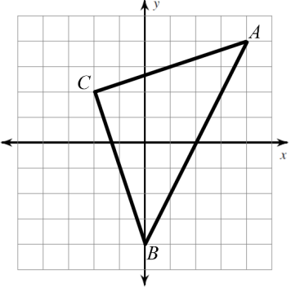
Main idea
Main idea
Rotation
Dilation
Rotate triangle ABC $180°$
Rotate triangle ABC $90°$ counter-clockwise:
Dilate triangle ABC by a scale factor of 2
Dilate triangle ABC by a scale factor of $\frac{1}{2}$
How does the transformation of a figure affect the size, shape, and position of that figure?

