Slide 1
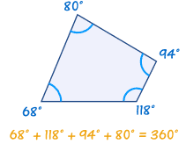
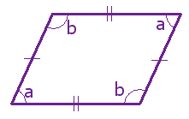
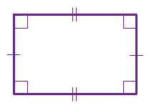
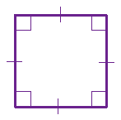
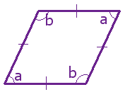
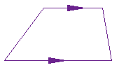
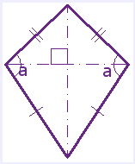

Key Topic: Quadrilaterals
classifying, comparing, and contrasting properties of quadrilaterals, which have four sides and four angles.
Is about…
Main Idea: Quadrilateral
Main Idea: Parallelogram
Main Idea: Rectangle
Main Idea: Square
Essential details & Sketch
Essential details & Sketch
Essential details & Sketch
Essential details & Sketch
Properties:
Opposite sides are congruent
Opposite sides are parallel
Opposite angles are congruent
Properties:
Opposite sides are congruent
Opposite sides are parallel
All four angles are right angles
Diagonals are the same length and bisect each other
(Bisect means to divide into two equal parts)
Properties:
All sides are congruent
Opposite sides are parallel
All angles are right angles
Diagonals are same length, bisect each other, and are perpendicular
A quadrilateral is a closed plane (two-dimensional) figure with four sides that are line segments. The interior angles add up to $360°$
Main Idea: Rhombus
Main Idea: Trapezoid
Main Idea: Isosceles Trapezoid
Main Idea: Kite
Essential details & Sketch
Essential details & Sketch
Essential details & Sketch
Essential details & Sketch
Properties:
All sides are congruent
Opposite sides are parallel
Opposite angles are congruent
Diagonals bisect each other and intersect at right angles
Properties:
Exactly one pair of opposite sides are parallel
Can have only one right angle ever.
Properties:
The non-parallel sides are congruent.
The base angles are also congruent.
Properties:
Has two pair of sides
Each pair made up of adjacent sides that are congruent
Angles are congruent where the pairs meet
Diagonals are perpendicular and one diagonal bisects the other
So What? Some quadrilaterals can be classified in more than one category based on their properties they share.

Slide 2
Key Topic: Quadrilaterals
classifying, comparing, and contrasting properties of quadrilaterals, which have four sides and four angles.
Is about…
Main Idea: Quadrilateral
Main Idea: Parallelogram
Main Idea: Rectangle
Main Idea: Square
Essential details & Sketch
Essential details & Sketch
Essential details & Sketch
Essential details & Sketch
Main Idea: Rhombus
Main Idea: Trapezoid
Main Idea: Isosceles Trapezoid
Main Idea: Kite
Essential details & Sketch
Essential details & Sketch
Essential details & Sketch
Essential details & Sketch
So What? Some quadrilaterals can be classified in more than one category based on their properties they share.

