Slide 1
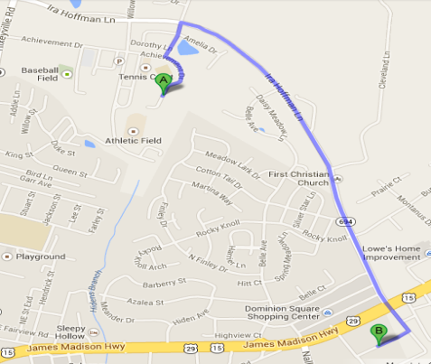
Key Topic
Properties of Operations
Is about…
Identifying properties of operations used in simplifying expressions and apply the properties of operations to simplify expressions.
Commutative Properties
Essential details
Associative Properties
Essential details
Distributive Property
Essential details
Multiplicative Property of Zero
Essential details

Slide 2
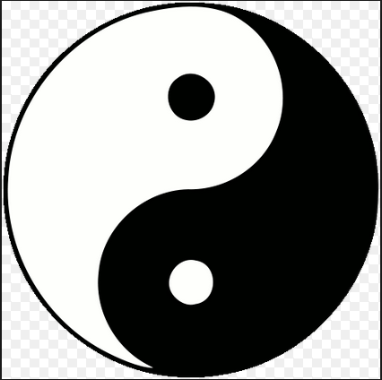
Identity Properties
Essential details
Inverse Properties
Essential details
So What?
Why is it important to apply properties of operations when simplifying expressions?
Identify which properties are used in the following number sentences below:
$$4\left(3+n\right)=\left(4∗3\right)+\left(4∗n\right)$$
$$\left(2+3\right)+4=\left(3+2\right)+4$$
$$\frac{4}{5}∗\frac{5}{4}=1$$
$$5∗\left(0∗m\right)=0$$
$$4x+\left(5+0\right)=2x+5$$
$$6+\left(−6\right)=0$$
$$\left(3+1\right)+5=3+\left(1+5\right)$$
$$9∗1=9$$

Slide 3

Key Topic
Properties of Operations
Is about…
Identifying properties of operations used in simplifying expressions and apply the properties of operations to simplify expressions.
Commutative Properties
Essential details
Associative Properties
Essential details
For addition states that changing the order of the addends does not change the sum (e.g., 5 + 4 = 4 + 5).
For multiplication states that changing the order of the factors does not change the product (e.g., 5 · 4 = 4 · 5).
Order does not matter
Your commute to school is the same as your commute home; as long as you follow the same route, the number of miles stays the same.
For addition states that regrouping the addends does not change the sum [e.g., 5 + (4 + 3) = (5 + 4) + 3].
Of multiplication states that regrouping the factors does not change the product [e.g., 5 · (4 · 3) = (5 · 4) · 3].
You can change the group of friends you associate with in school, but you still all belong to the same school.
** Subtraction and division are neither commutative nor associative.
** Subtraction and division are neither commutative nor associative.
Distributive Property
Essential details
Multiplicative Property of Zero
Essential details
When you distribute something you pass it out, like a mailman distributing mail.
You pass out what is on the outside of the parenthesis to what is on the inside of the parenthesis.
5 · (3 + 7) = (5 · 3) + (5 · 7) or 5 · (3 – 7) = (5 · 3) – (5 · 7)
The multiplicative property of zero states that the product of any real number and zero is zero.
$5∗0=0$
$a∗0=0$
** Division by zero is not a possible arithmetic operation. Division by zero is undefined.

Slide 4
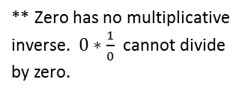
Identity Properties
Essential details
Inverse Properties
Essential details
The additive identity property states that the sum of any real number and zero is equal to the given real number ( 5 + 0 = 5).
The multiplicative identity property states that the product of any real number and one is equal to the given real number (e.g., 8 · 1 = 8).
When you take a selfie of yourself using your camera phone your identity does not change.
There are no identity elements for subtraction and division.
The additive inverse property states that the sum of a number and its opposite always equals zero [e.g., 5 + (–5) = 0].
The multiplicative inverse property states that the product of a number and its multiplicative inverse (or reciprocal) always equals one (e.g., 4 · = 1).
Inverses are numbers that combine with other numbers and result in identity elements.
Doing the opposite, yin and yang
** The additive identity is zero (0). The multiplicative identity is one (1).
** Zero has no multiplicative inverse. $0∗\frac{1}{0}$cannot divide by zero.
So What?
Why is it important to apply properties of operations when simplifying expressions?
Identify which properties are used in the following number sentences below:
$$4\left(3+n\right)=\left(4∗3\right)+\left(4∗n\right)$$
$$\left(2+3\right)+4=\left(3+2\right)+4$$
$$\frac{4}{5}∗\frac{5}{4}=1$$
$$Distributive Property$$
$$Commutative Property of Addition$$
$$Multiplicative Inverse$$
$$5∗\left(0∗m\right)=0$$
$$4x+\left(5+0\right)=2x+5$$
$$Multiplication Property of Zero$$
$$Additive Identity$$
$$6+\left(−6\right)=0$$
$$\left(3+1\right)+5=3+\left(1+5\right)$$
$$9∗1=9$$
$$Additive Inverse$$
$$Associative Property of Addition$$
$$Multiplicative Identity$$

