Slide 1
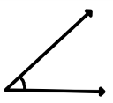
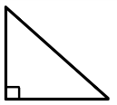
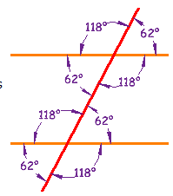
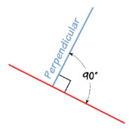
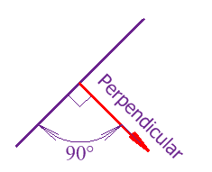
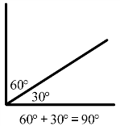
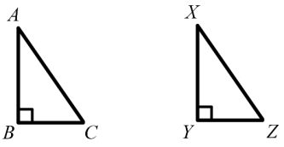
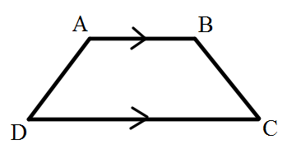
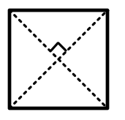
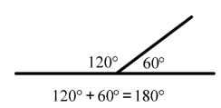
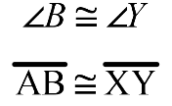
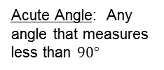
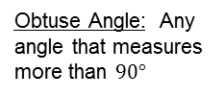
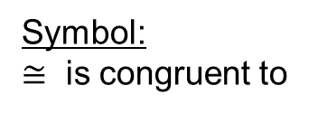
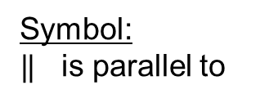


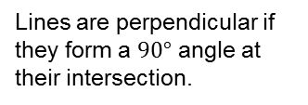
Key Topic
The FRAME Routine
Geometry Knowledge
is about…
understanding the basics of geometry such as symbols, angles, and the coordinate plane.
Angles
Congruent
Parallel
Perpendicular
Essential Details
Essential Details
Essential Details
Essential Details
Acute Angle: Any angle that measures less than $90°$
→ Two line segments are congruent if they have the same length.
Lines are parallel if they are always the same distance apart and will never meet.
Lines are perpendicular if they form a $90°$ angle at their intersection.
Right Angle: Any angle that measures exactly $90°$
→ Two angles are congruent if they have the same measure.
Symbol:
$‖$ is parallel to
Symbol:
┴ is perpendicular to
Obtuse Angle: Any angle that measures more than $90°$
Symbol:
$≅$ is congruent to
Complimentary Angles: two angles with the sum of $90°$
Supplementary Angles: two angles with the sum of $180°$
$$\overline{AB} ‖ \overline{DC}$$
Line AB is parallel to line DC
The diagonals of a square are perpendicular

Slide 2
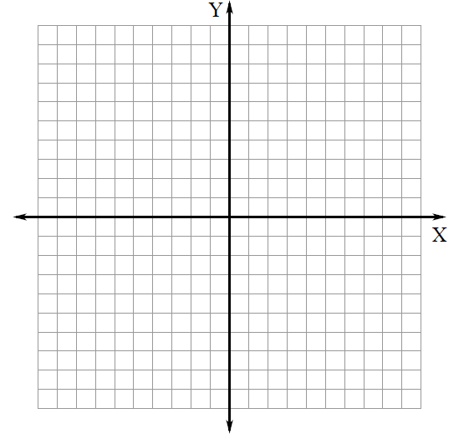
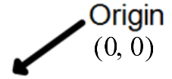

Coordinate Plane
x-axis: runs horizontally (left to right) through zero
y-axis: runs vertically (down to up) through zero
Ordered Pair: $(x, y)$
Graph x coordinate first go left (negative) or right (positive).
Graph y coordinate second go down (negative) or up (positive).
To graph the point $(−3, 6)$ go three units left and six units up
To graph the point $(4, −2)$ go four units right and two units down
To graph the point $\left(−5, 0\right)$ go five units left and do not go up or down.
To graph the point $(0, −6)$ do not go left or right and go down 6 units.
So What? (What’s important to understand about this?)
With a basic understanding of symbols, angles, and the coordinate plane we are able to investigate geometric shapes and explore geometric transformations.

Slide 3
Key Topic
The FRAME Routine
Geometry Knowledge
is about…
understanding the basics of geometry such as symbols, angles, and the coordinate plane.
Angles
Congruent
Parallel
Perpendicular
Essential Details
Essential Details
Essential Details
Essential Details
Acute Angle:
.
.
Right Angle:
.
Symbol:
Symbol:
Obtuse Angle:
Symbol:
Complimentary Angles:
Supplementary Angles:

Slide 4
Coordinate Plane
x-axis:
y-axis:
Ordered Pair:
So What? (What’s important to understand about this?)

